Slide 1

Project Title - Seasonal-Agriculture-Performance-Insights
Student Name- Ritam Saha
College Name- Institute of Engineering & Management
AICTE STU ID : STU6970f746c5c821769011014

Slide 2

PROBLEM STATEMENT
Agricultural performance is shaped by seasonal variation in environmental conditions, farming practices, resource availability, and market forces — but raw agricultural data on its own doesn't reveal how performance changes across seasons or what patterns drive those differences. The problem this project addresses is: analyze seasonal agricultural data to uncover meaningful patterns, trends, relationships, and variations in performance across seasons (Kharif, Rabi, Zaid), going beyond simple seasonal averages to understand why performance differs and what actionable levers exist for each season.

Slide 3
Project Description
This project is a data analytics study of 4,000 farm-level records spanning three growing seasons, covering environmental conditions (rainfall, temperature, soil moisture/pH), resource usage (water, fertilizer, pesticide, irrigation method), and economic outcomes (yield, revenue, cost, profit). Rather than a generic "compare means by season" exercise, it builds a composite Farm Performance Index, uses K-Means clustering to discover natural farm archetypes, runs season-specific driver regressions to see whether the same input matters differently in different seasons, computes risk-adjusted profitability (consistency, not just averages), benchmarks top vs. bottom decile farms within each season, and flags statistical anomalies via Isolation Forest. The output is a fully documented, reproducible Google Colab with visualizations, statistical validation (ANOVA, Pearson correlation), and evidence-based recommendations for seasonal agricultural planning.

Slide 4

WHO ARE THE END USERS?
Government agriculture departments — for evidence-based seasonal planning, subsidy targeting, and extension program design.
Agricultural extension officers & advisors — to give farmers season-specific, data-backed input recommendations rather than generic advice.
Farmers and farmer cooperatives — to benchmark their own practices against top-performing peers in the same season and region.
Agri-tech companies & agri-fintech (crop insurance, input suppliers) — to identify high-risk seasons/regions and design better products (insurance pricing, targeted fertilizer/seed marketing).
Researchers and students — as a case study in applied seasonal/agricultural data analytics

Slide 5

Technology Used
Language: Python 3
Environment: Google Colab
Data handling: pandas, NumPy
Visualization: Matplotlib, Seaborn
Statistics: SciPy (ANOVA, Pearson correlation)
Machine learning: scikit-learn — (StandardScaler, K-Means clustering, Isolation Forest, Linear Regression)
Version control : Git & GitHub

Slide 6
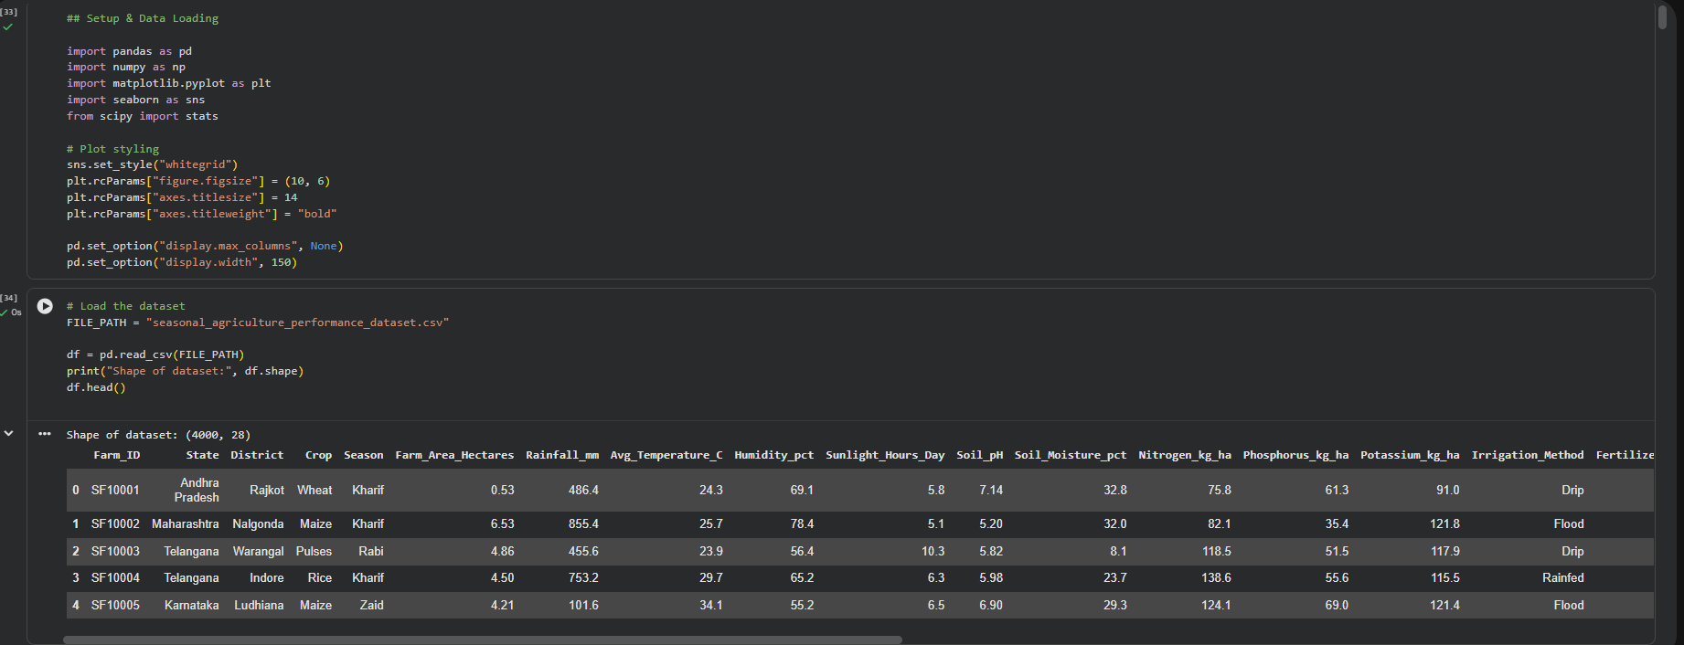
RESULTS

Slide 7
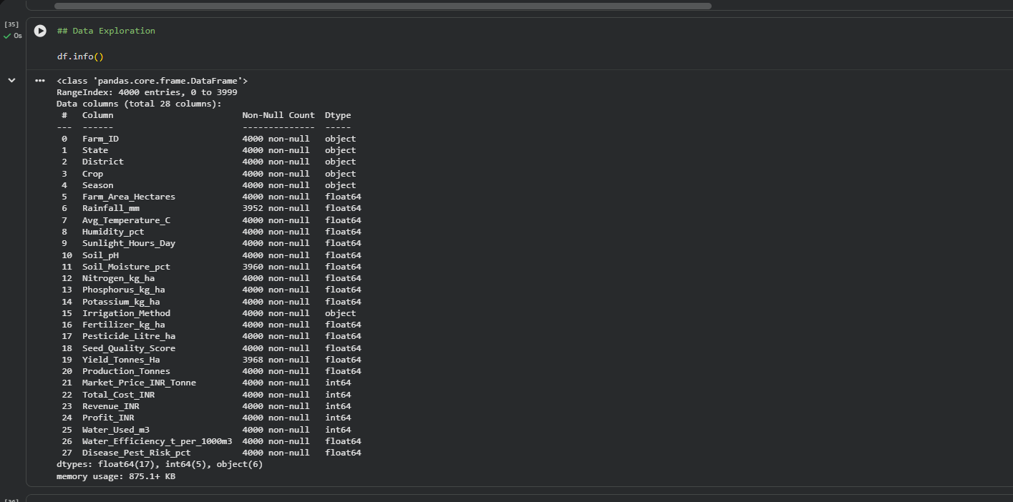
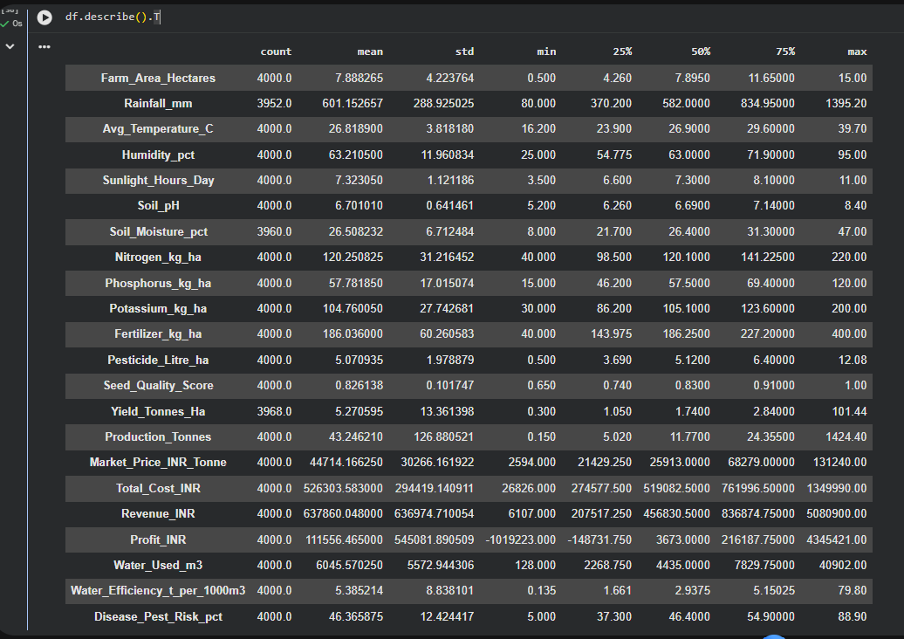
RESULTS

Slide 8
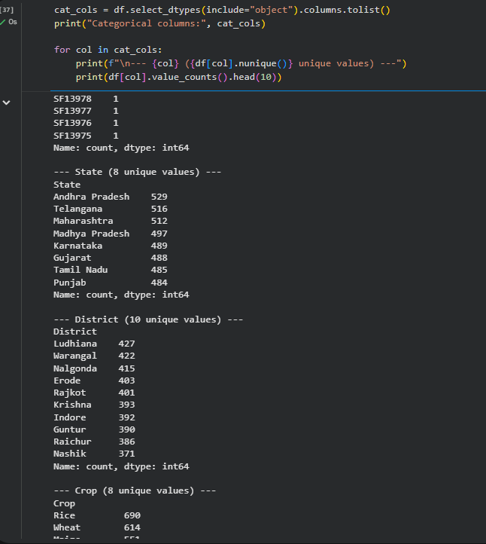
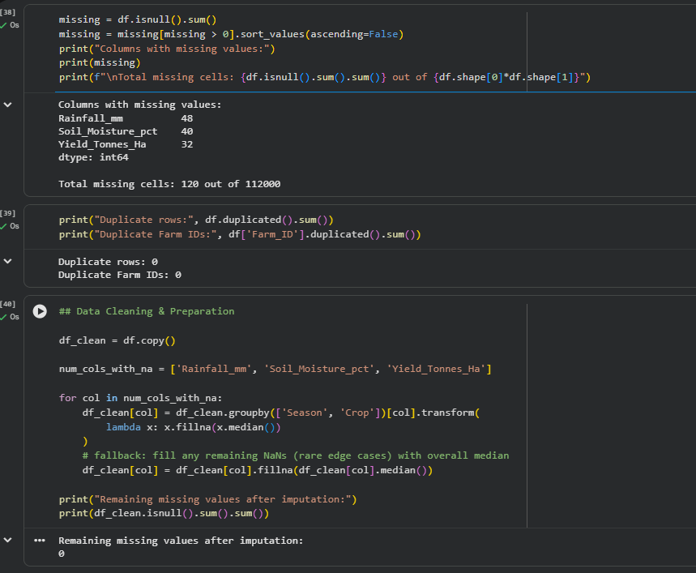
RESULTS

Slide 9
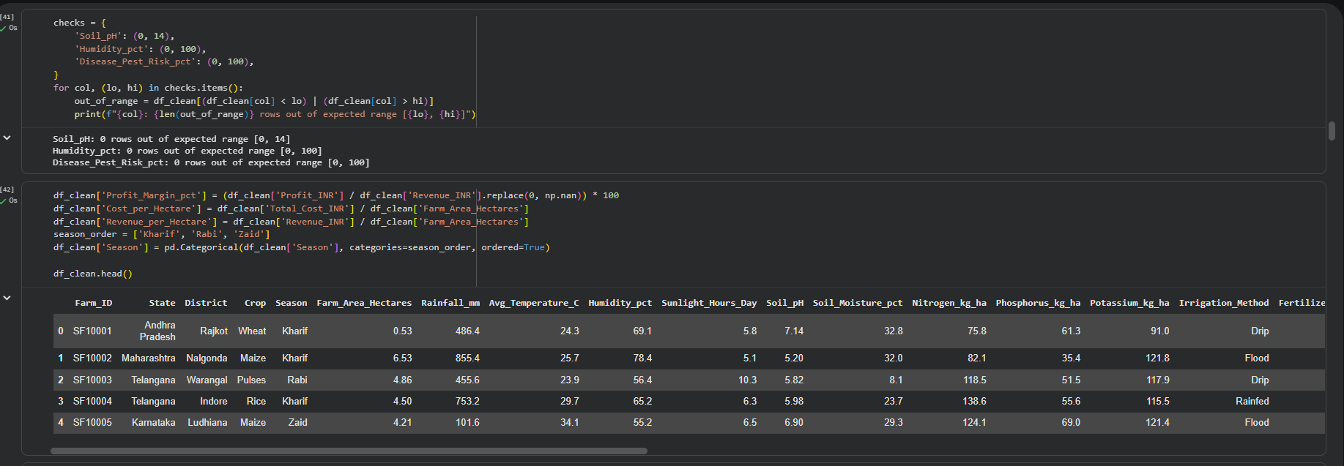
RESULTS

Slide 10
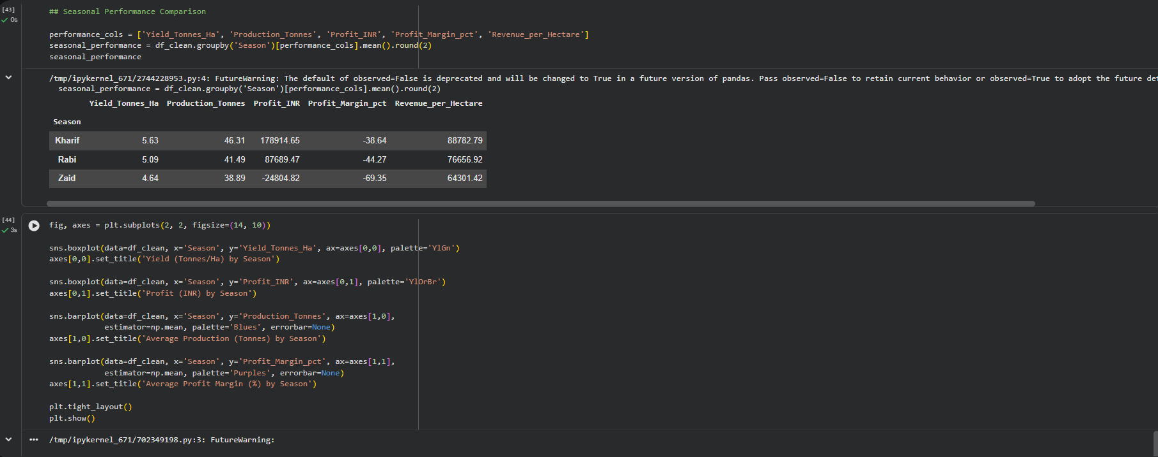
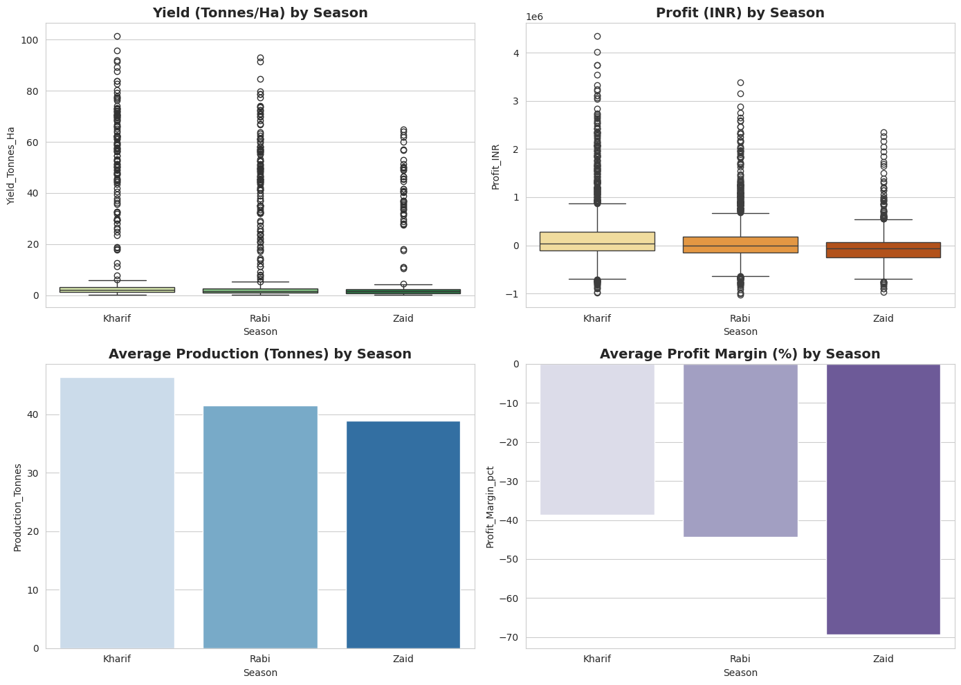
RESULTS

Slide 11
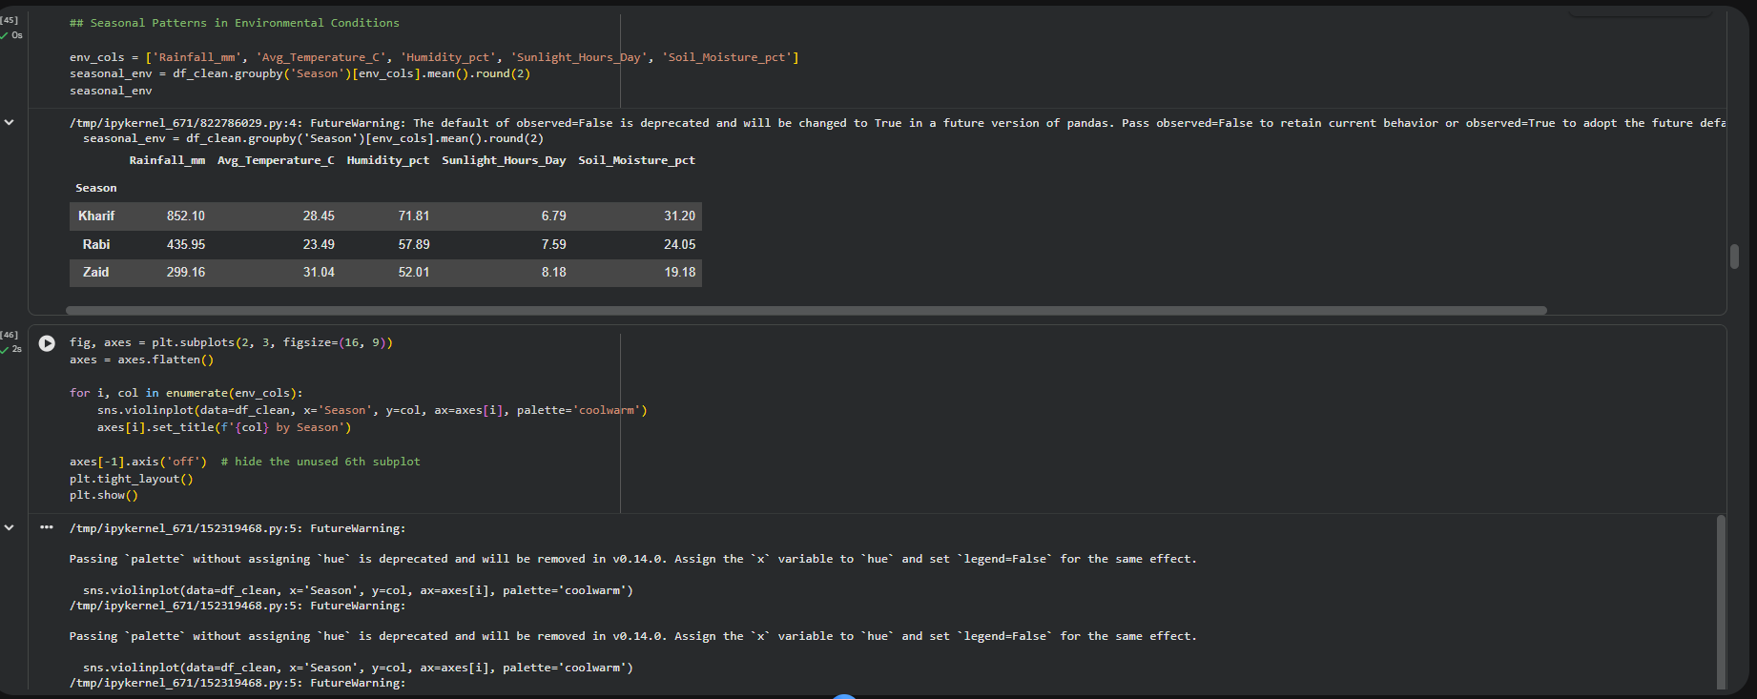
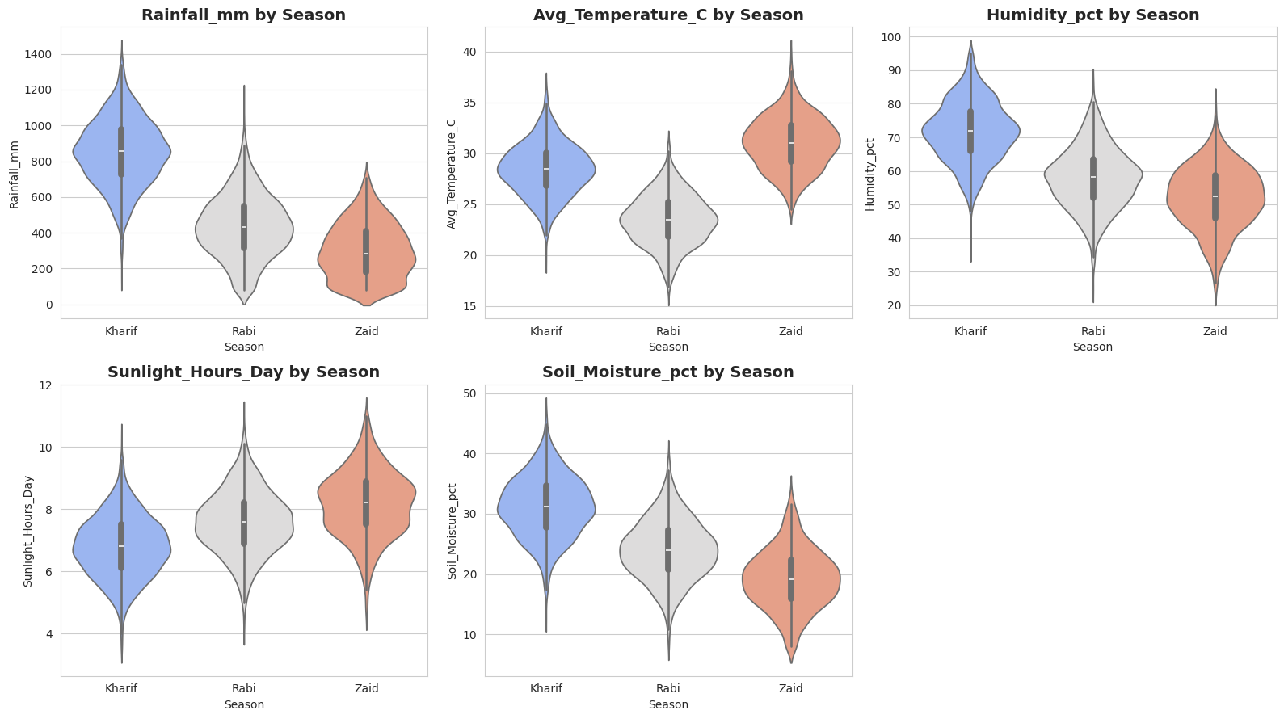
RESULTS

Slide 12
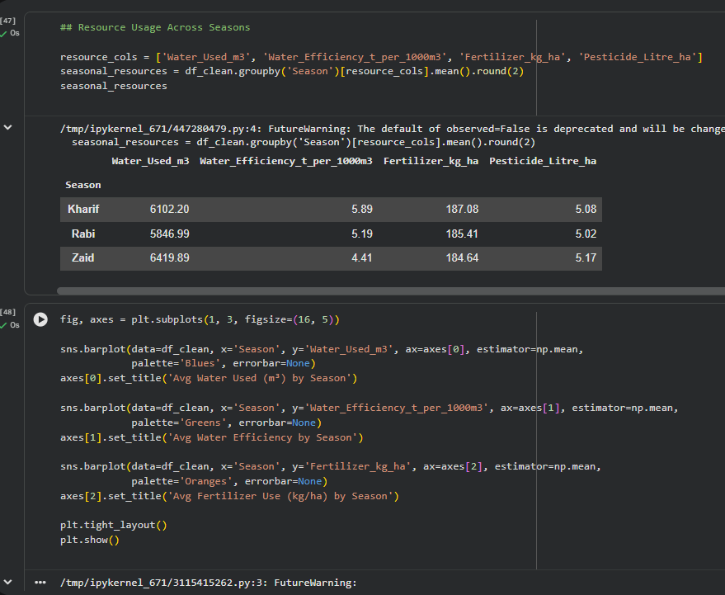
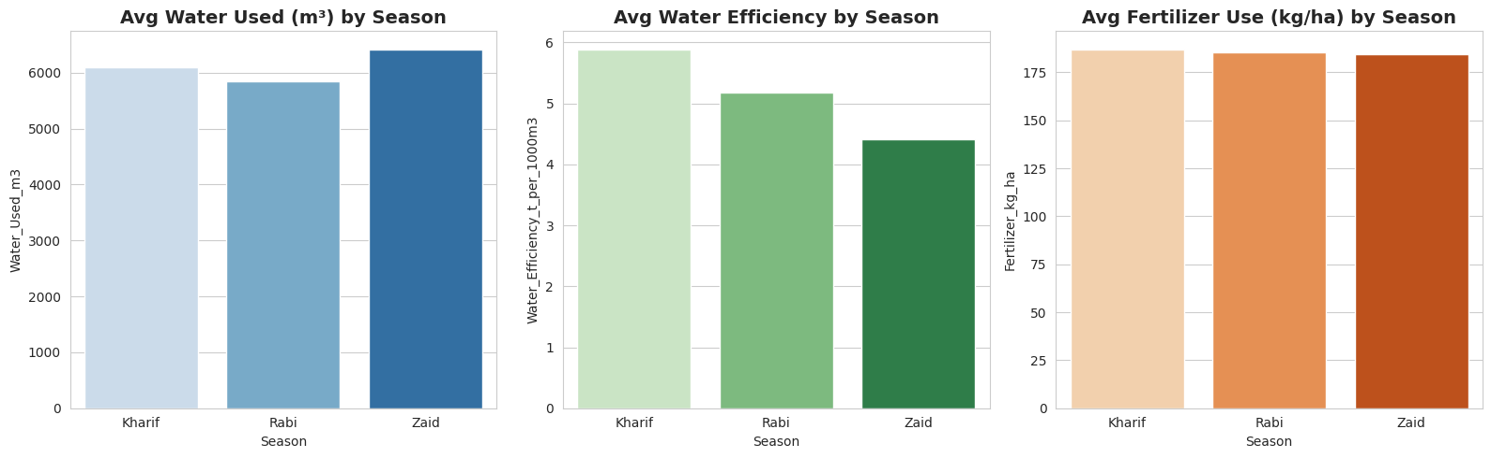
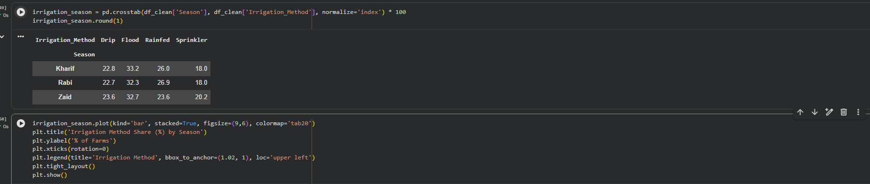
RESULTS

Slide 13
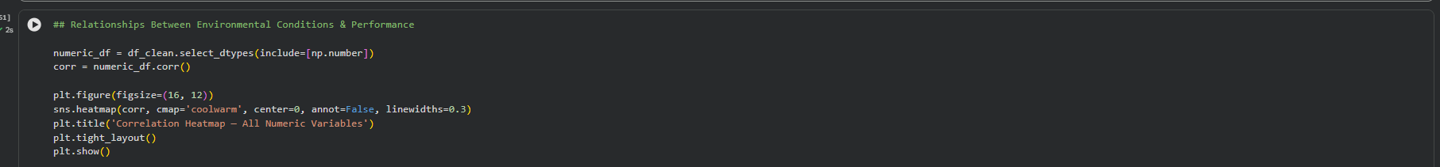
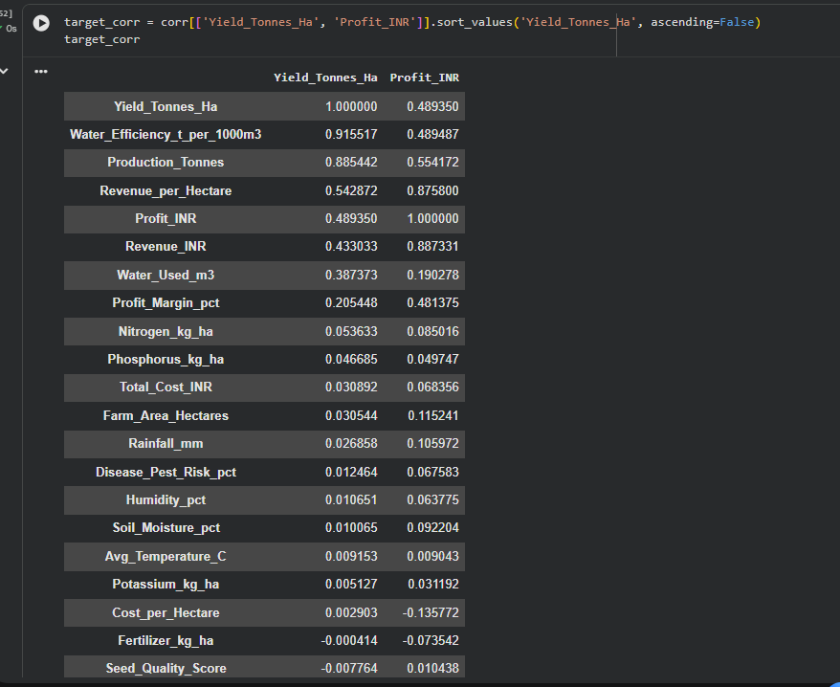
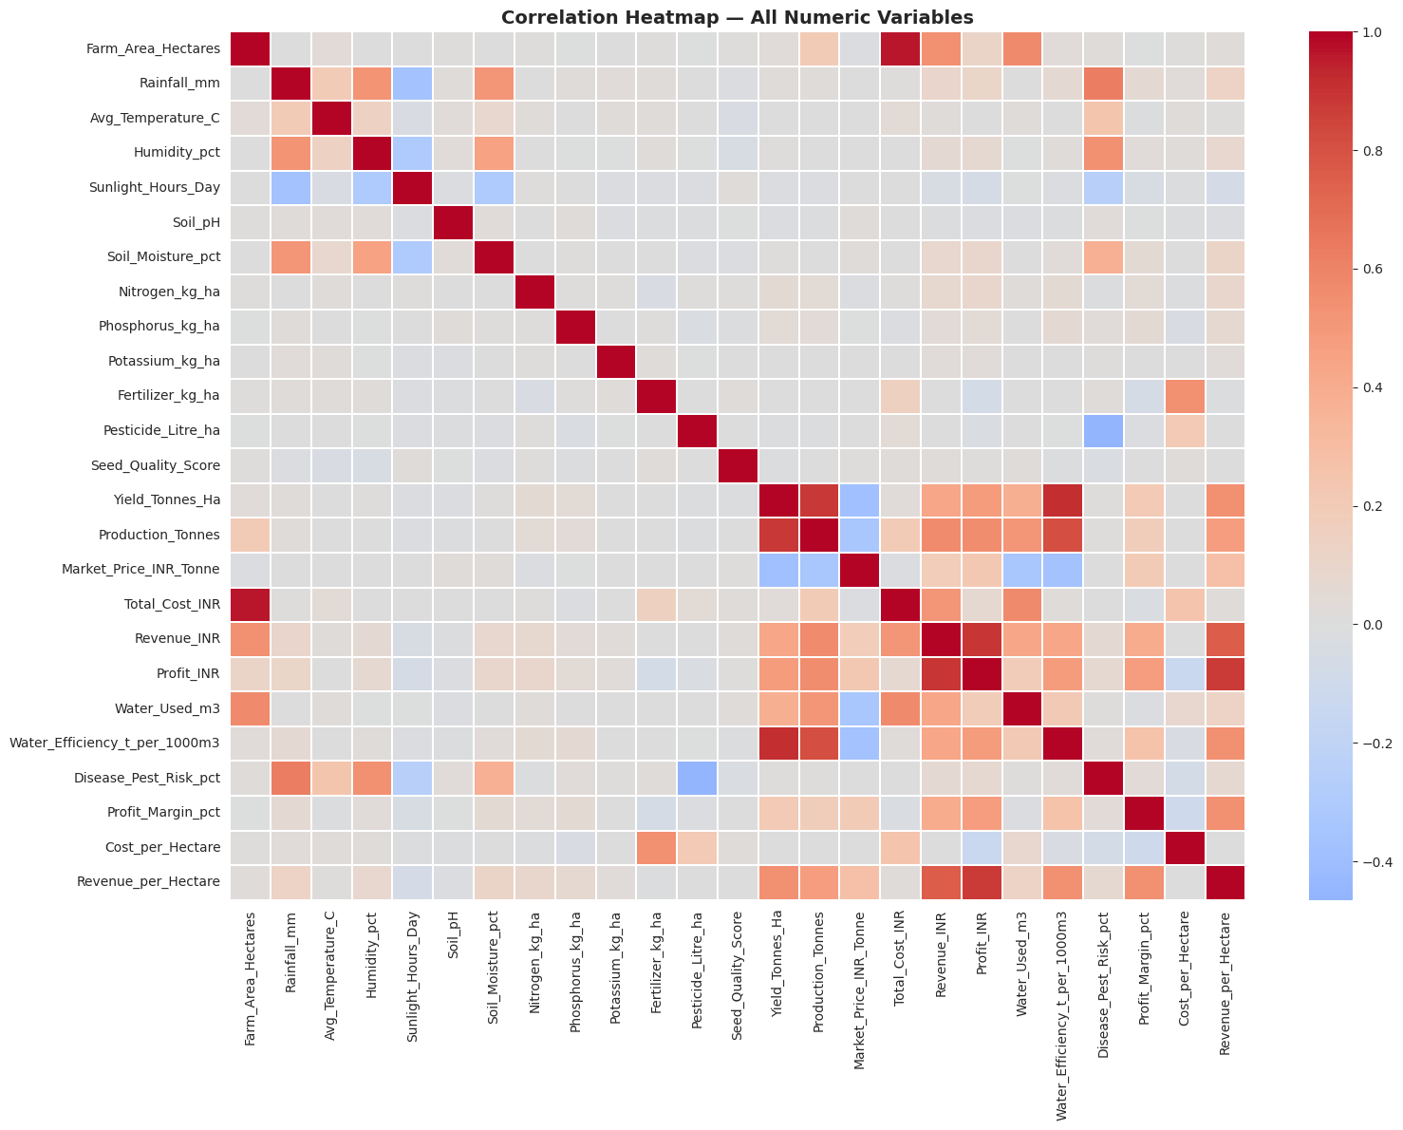
RESULTS

Slide 14
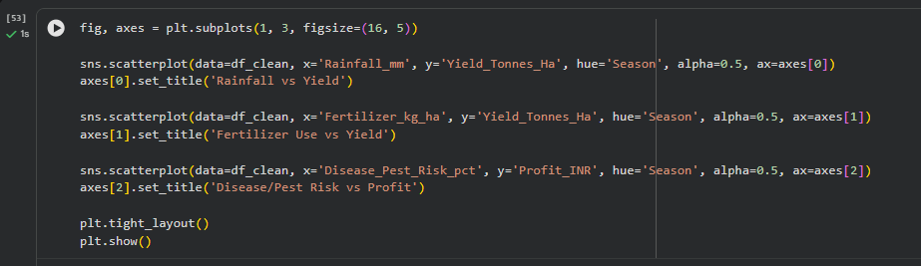
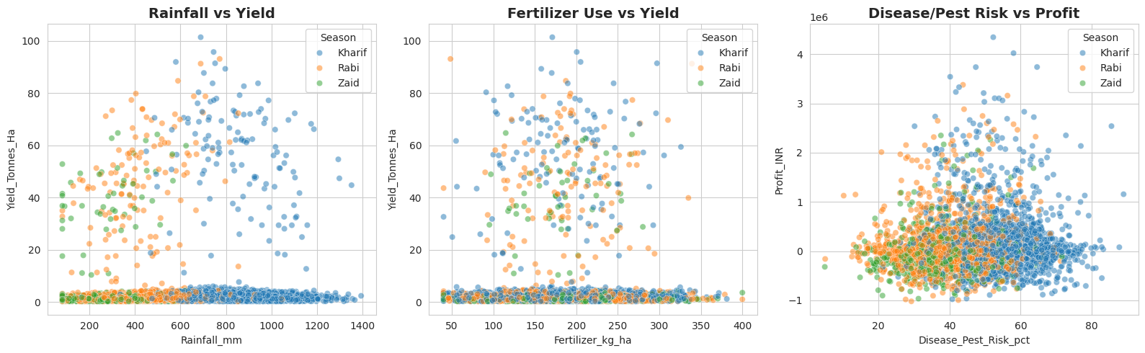
RESULTS

Slide 15
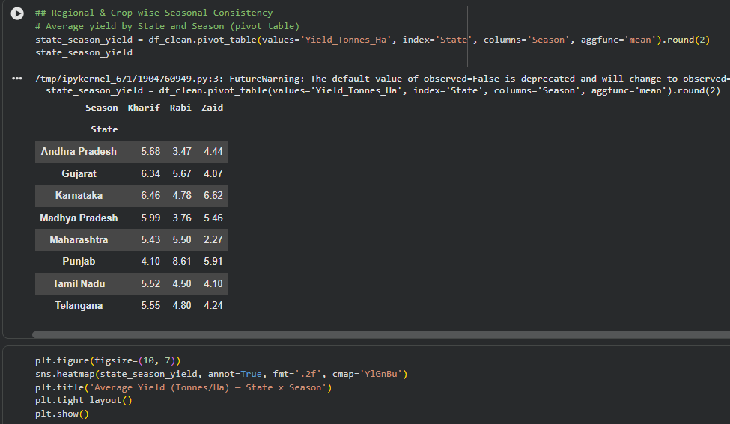
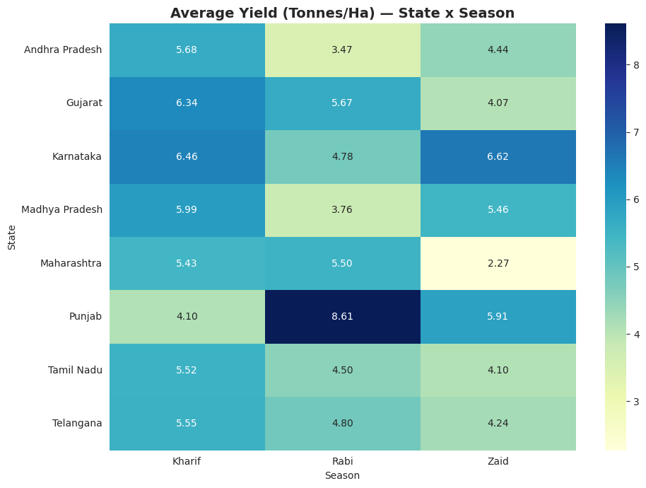
RESULTS

Slide 16
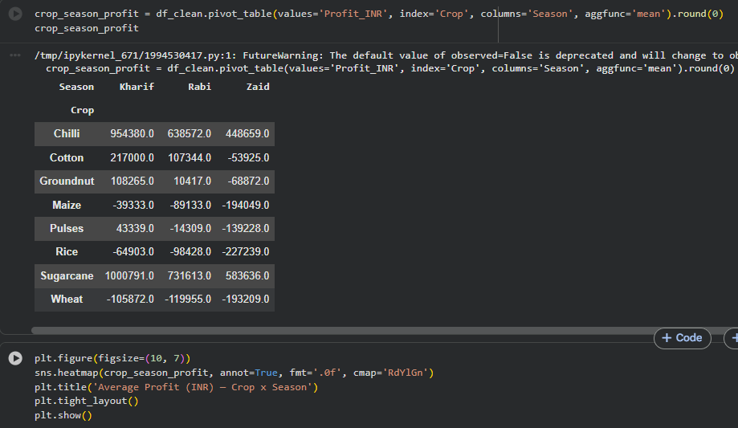
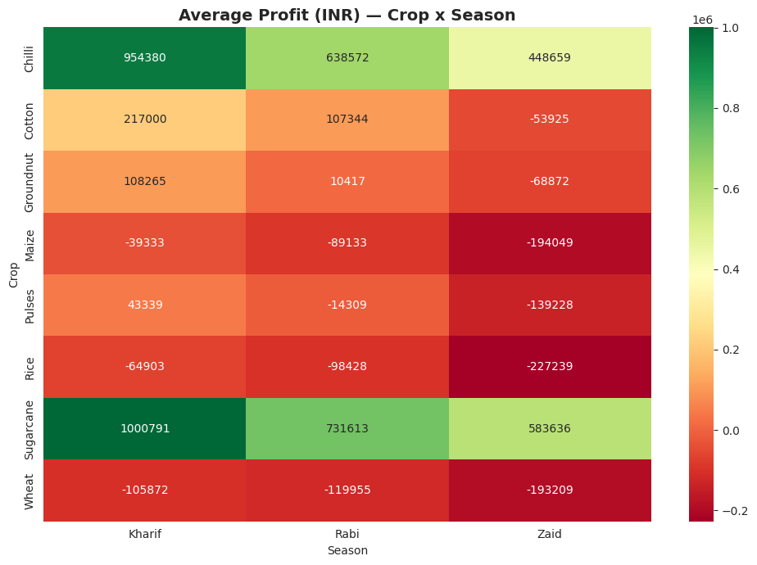
RESULTS

Slide 17
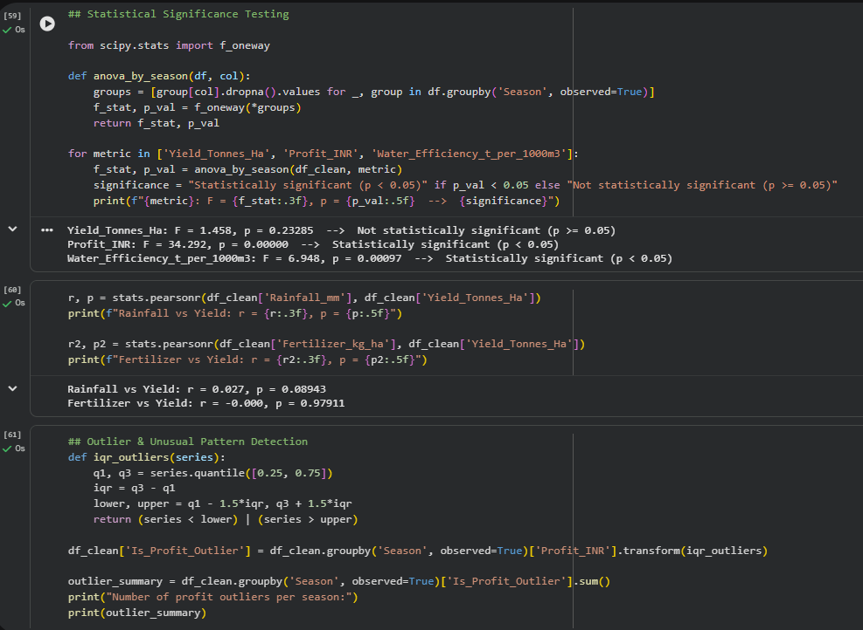
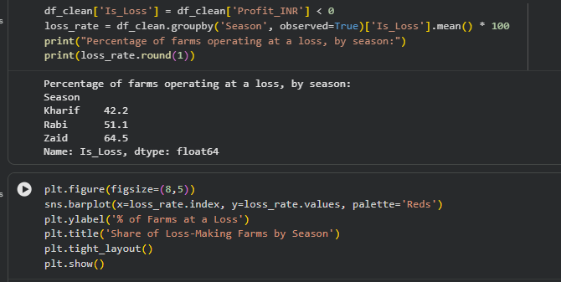
RESULTS

Slide 18
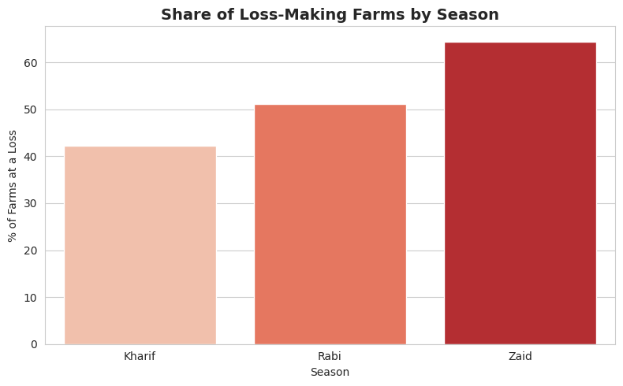
RESULTS

Slide 19
Future scope
Predictive modeling — build regression/ML models (Random Forest, XGBoost) to predict yield or profit ahead of a season using weather forecasts and planned inputs, rather than only explaining past outcomes
Time-series expansion — extend beyond seasonal snapshots to multi-year trend analysis to detect long-term climate-driven shifts in seasonal performance
Geospatial analysis — integrate GIS/satellite data (soil maps, NDVI vegetation indices) for finer-grained regional recommendations
Real-time dashboard — deploy findings as an interactive dashboard (Streamlit/Power BI/Tableau) for extension officers or farmers to query live
Weather API integration — pull live/forecast weather data to make the season-specific driver insights dynamically actionable
Crop-recommendation engine — extend the clustering/archetype work into a recommender system suggesting optimal crop-season-region combinations for a given farm profile

Slide 20
GitHub Link
GitHub Repository Link-
https://github.com/ritam-5/Seasonal-Agriculture-Performance-Insights.git

Slide 21

VOIS Course completion certificate -
Course name- Data Visualization

Slide 22
Thank you
.
.

